Slide 1
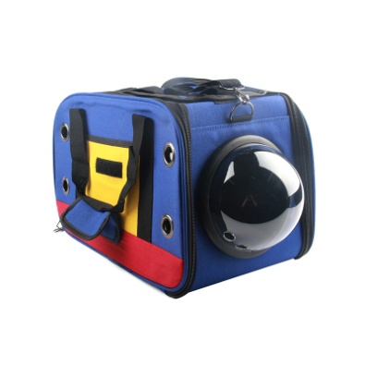
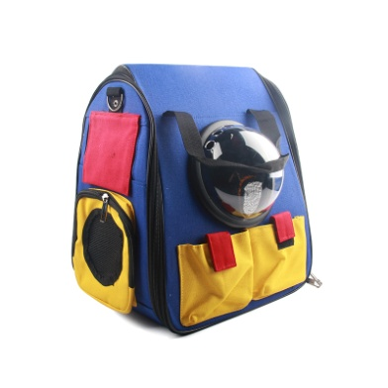
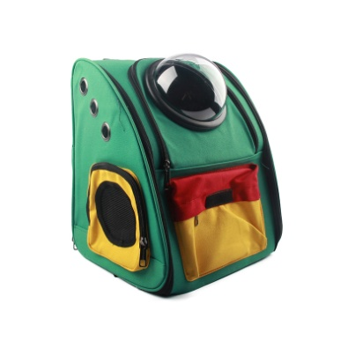
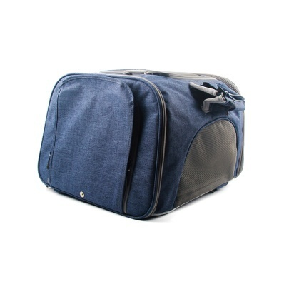
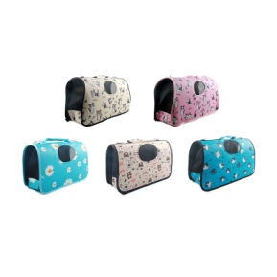
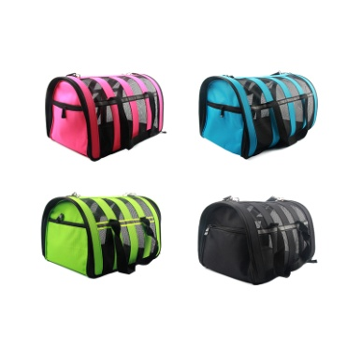
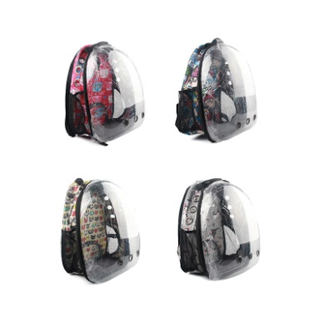
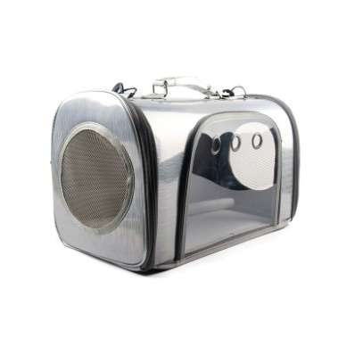
PET CARRIER SERIES
Make your pet more and more cute!
TKB001
TKB002
TKB003
TKB004
Pet Bag
45*27*28cm/1600g
24pcs
Pet Bag
38*28*41cm/1650g
24pcs
Pet Bag
35*30*40cm/1700g
24pcs
Pet Bag
41*30*41cm/1350g
24pcs
TKB005
TKB007
TKB008
TKB009
Pet Bag
S:38*15*24cm/600g
M:44*20*27cm/750g
L:53*21*29cm/1000g
Pet Bag
S:37*24*21cm/600g
M:41*26*25cm/750g
L:49*30*26cm/800g
Pet Bag
35*26*44cm/800g
24pcs
Pet Bag
44*23*28cm/1100g
24pcs
003

Slide 2
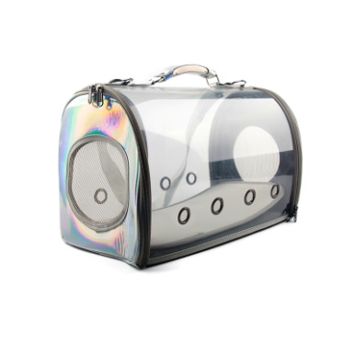
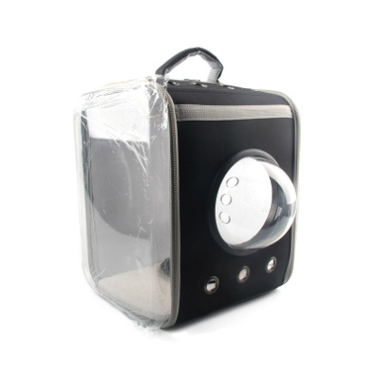
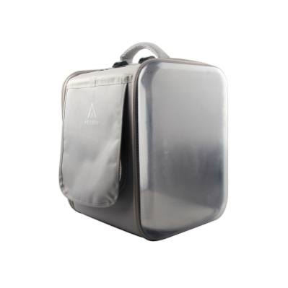
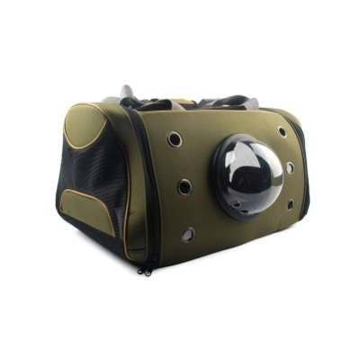
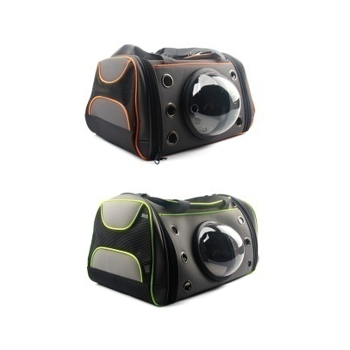
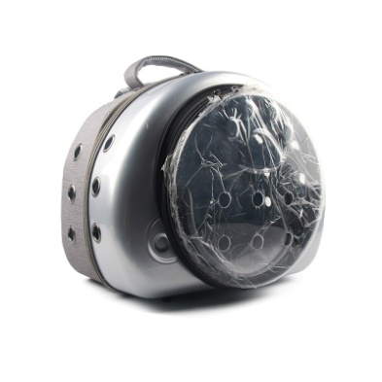
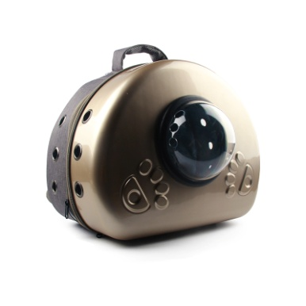
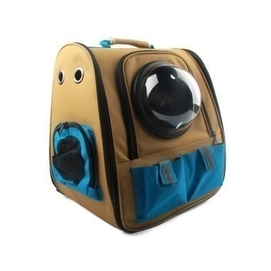
PET CARRIER SERIES
Make your pet more and more cute!
TKB010
TKB011
TKB012
TKB013
Pet Bag
43*28*25cm/1050g
24pcs
Pet Bag
34*30*40cm/1450g
24pcs
Pet Bag
35*31*40cm/1350g
24pcs
Pet Bag
54*35*29cm/1350g
24pcs
TKB014
TKB015
TKB016
TKB017
Pet Bag
S:49*32*26cm
L:54*35*29cm
Pet Bag
42*26*35cm/1450g
24pcs
Pet Bag
42*23*35cm/1500g
24pcs
Pet Bag
36*28*40cm/1750g
24pcs
003

Slide 3
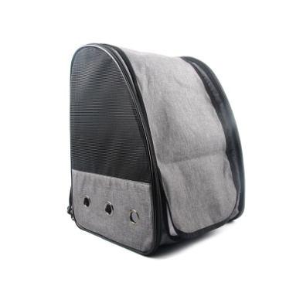
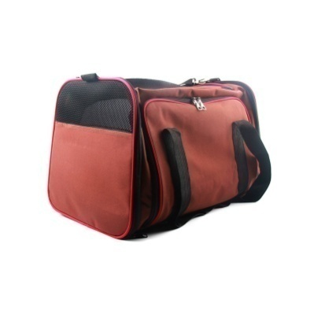
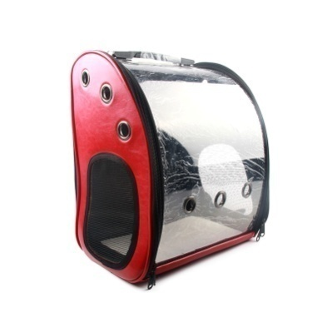
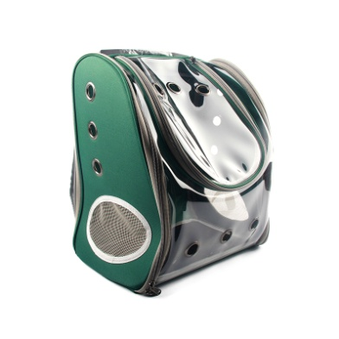
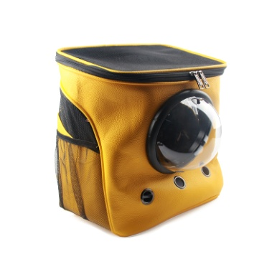
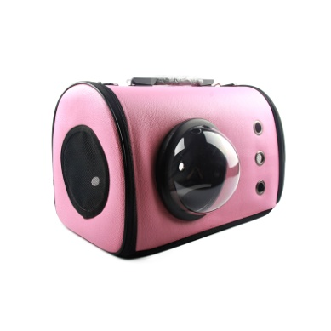
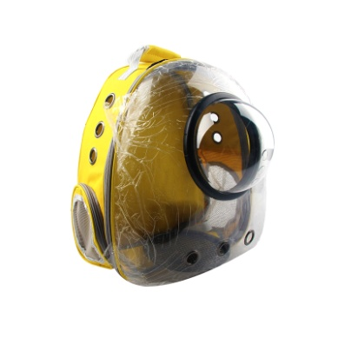
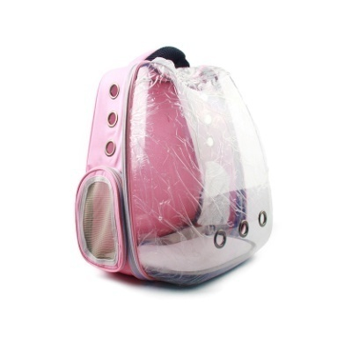
PET CARRIER SERIES
Make your pet more and more cute!
TKB018
TKB019
TKB020
TKB021
Pet Bag
33*29*42cm/1300g
24pcs
Pet Bag
47*32*31cm/1400g
24pcs
Pet Bag
36*24*38cm/1200g
24pcs
Pet Bag
33*23*39cm/1150g
24pcs
TKB022
TKB023
TKB024
TKB025
Pet Bag
31*25*34.5cm/1200g
24pcs
Pet Bag
43*26*27cm/1550g
24pcs
Pet Bag
34*24*39cm/1000g
24pcs
Pet Bag
36*28*39cm/1050g
24pcs
003

Slide 4
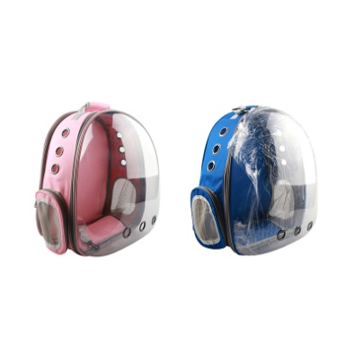
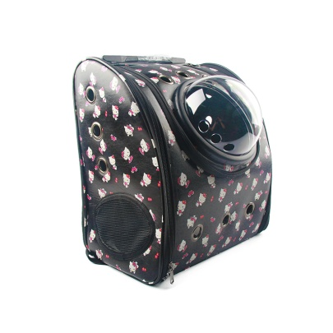
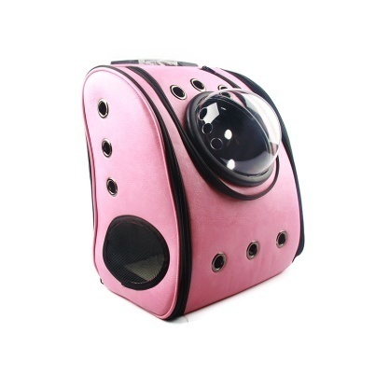
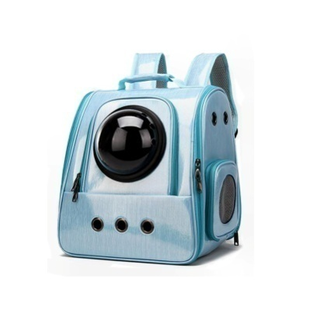
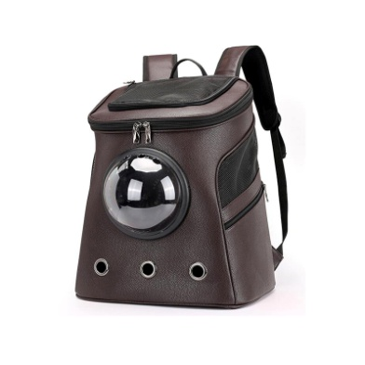
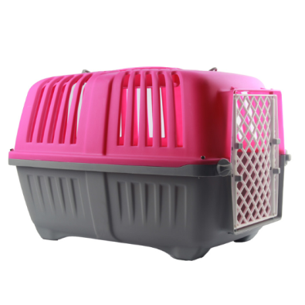
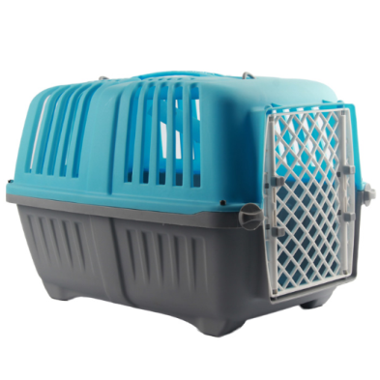
PET CARRIER SERIES
Make your pet more and more cute!
TKB026
TKB027
TKB028
TKB029
Pet Bag
33*26*42cm/1000g
24pcs
Pet Bag
33*23*37cm/1200g
24pcs
Pet Bag
33*33*40cm/1300g
24pcs
Pet Bag
36*29*40cm/1700g
24pcs
TKB030
YB06
YB07
TKB
Pet Bag
42*27*46cm/1600g
24pcs
Pet Carrier
55*34*37cm/1307g
10pcs/0.128m³
Pet Carrier
46*29*32cm/968g
12pcs/0.098m³
Pet PP Bowl
26*19*7cm/136g
40pcs/0.026m³
003

Slide 5
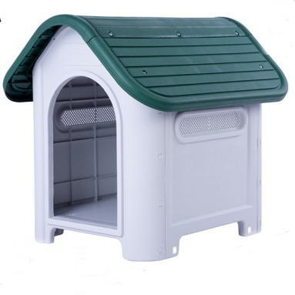
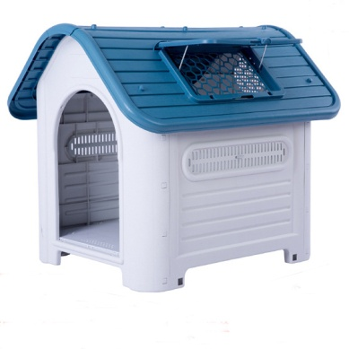
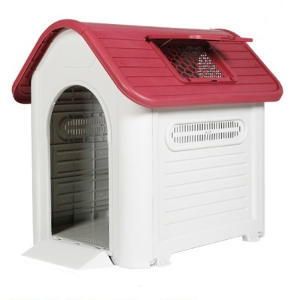
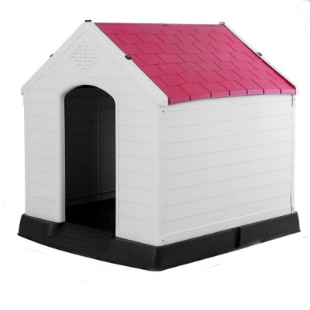
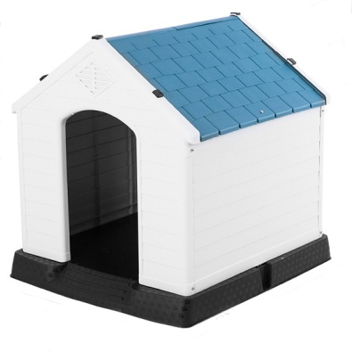
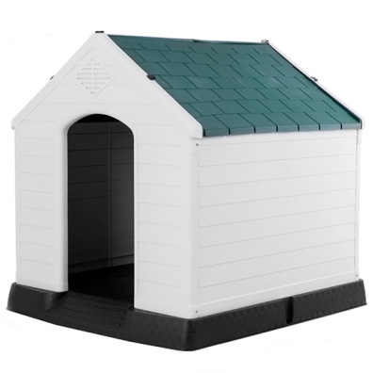
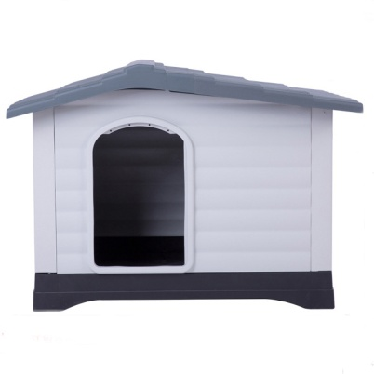
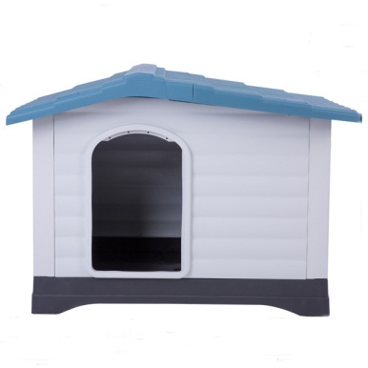
PET HOUSE SERIES
Make your pet more and more cute!
XDB-403
XDB-419
XDB-419A
XDB-413
Pet House
75*59*66cm/5000g
1pc/0.074m³
Pet House
87*72*75.5cm/8300g
1pc/0.095m³
Pet House
117*97*113cm/18400g
1pc/0.263m³
Pet House
105*96.5*98.5cm/13000g
1pc/0.148m³
XDB-426
XDB-427
XDB-424
XDB-424S
Pet House
87.7*78.5*81.5cm/9750g
1pc/0.103m³
Pet House
73.6*66.5*69.5cm/6800g
1pc/0.068m³
Pet House
111.1*83.8*80.4cm/13900g
1pc/0.238m³
Pet House
68.9*91.4*66cm/13600g
1pc/0.115m³
003

Slide 6
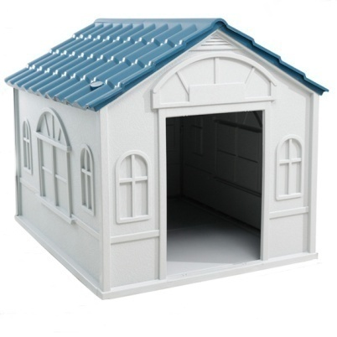
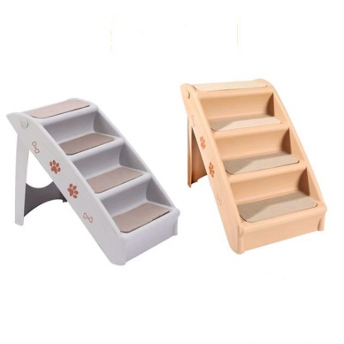
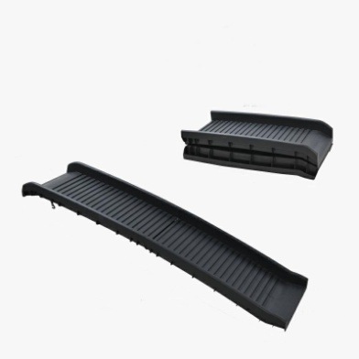
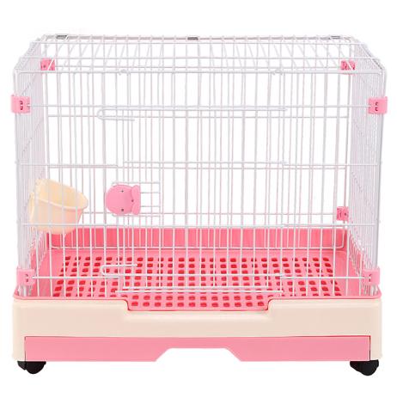
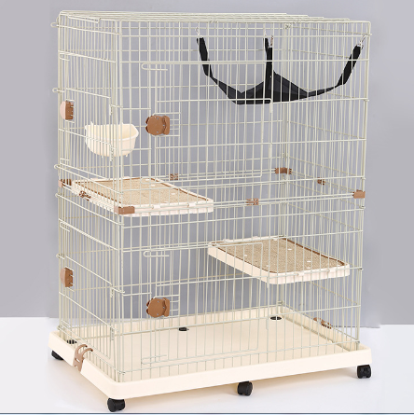
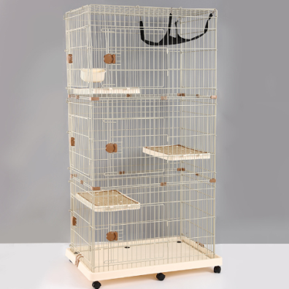
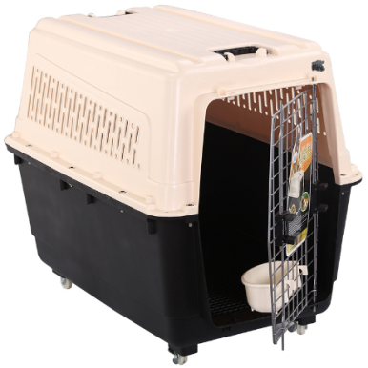
PET HOUSE SERIES
Make your pet more and more cute!
XDB-432
XDB-432S
XDB-433
XDB-428
Pet House
87.7*78.5*81.5cm/9750g
1pc/0.103m³
Pet House
75.7*65*63.2cm/4900g
1pc/0.059m³
Pet Stairs
62*40*49.5cm/2200g
1pc/0.043m³
Pet Ramp
Open:155*40*15cm
Folding:79.5*40*20cm
1pc/0.068m³
BP204/232
BP267
BP268
BP216/217/273
Pet Cage
58*42*51cm/5500g
72*53*60cm/8900g
Cat Cage
84*55*114cm/16328g
1pc/0.105m³
Cat Cage
84*55*167cm/22728g
1pc/0.113m³
Pet Cage
110*67*75cm/12480g
90*60*70cm/10400g
80*57*66cm/8400g
003

Slide 7
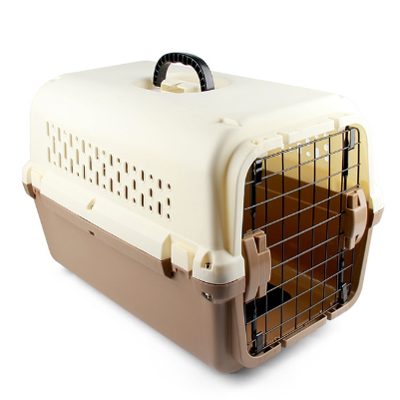
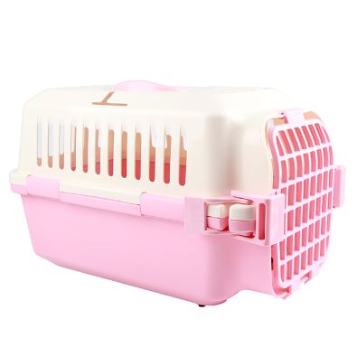
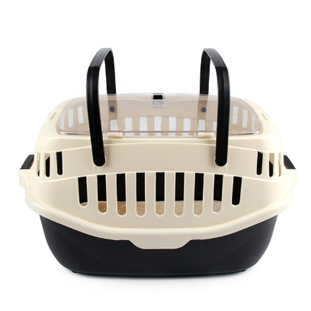
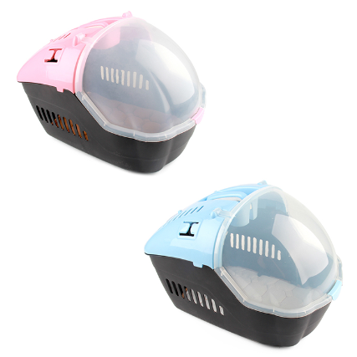
PET HOUSE SERIES
Make your pet more and more cute!
BP270/274/275
BP148
BP199
BP238/239
Pet Cage
42*30*31cm/1350g
51*33*34cm/1850g
59*40*40cm/2550g
Pet Cage
50*30*31cm/1450g
6pcs/0.067m³
Pet Cge
54*33.5*30cm/1400g
6pcs/0.089m³
Pet Cge
46*32.5*32cm/1300g
55*39*38cm/2000g
BP258
BP228
BP200
B
Pet Cage
45*26*29cm/1250g
6pcS/0.206m³
Pet Cage
59*42*43cm/1950g
1pc/0.107m³
Pet Cage
48*42*29cm/1650g
1pc/0.064m³
Pet Cage
110*67*75cm/12480g
90*60*70cm/10400g
80*57*66cm/8400g
003

Slide 8
PET LEAD SERIES
Make your pet more and more cute!
SZ20
LS154
LS157
LS171
Pet Retractable Leash
5m/350g
48pcs/0.073m³
Pet Retractable Leash
5m/421g
48pcs/0.083m³
Pet Retractable Leash
3m/179g
48pcs/0.042m³
Pet Retractable Leash
3m/154g
48pcs/0.029m³
LS172
LS173
LS195
LS206
Pet Retractable Leash
5m/272g
48pcs/0.047m³
Pet Retractable Leash
8m/442g
48pcs/0.062m³
Pet Retractable Leash
8m/693g
24pcs/0.065m³
Pet Retractable Leash
5m/466g
50pcs
003

Slide 9
PET LEAD SERIES
Make your pet more and more cute!
LS142
LS174
LS132
MS-701
Pet Retractable Leash
3m/105g
48pcs/0.034m³
Pet Retractable Leash
4m/223g
48pcs/0.051m³
Pet Retractable Leash
5m/316g
48pcs/0.086m³
Pet Retractable Leash
3m/5m
24pcs
MS-708
MS-800
MS-3016
MS-5016
Pet Retractable Leash
3m/5m/8m
24pcs
Pet Retractable Leash
3m/119g
72pcs
Pet Retractable Leash
5m/ 8m
24pcs
Pet Retractable Leash
5m/388g
24pcs
003

Slide 10
PET LEAD SERIES
Make your pet more and more cute!
ST02
ST03
ST04
ST05
Pet Retractable Leash
5m/280g
72pcs/0.098m³
Pet Retractable Leash
5m/202g
100pcs/0.098m³
Pet Retractable Leash
5m/207g
100pcs/0.098m³
Pet Retractable Leash
5m/208g
100pcs/0.098m³
ST06
MS-800
MS-3016
MS-5016
Pet Retractable Leash
5m/232g
100pcs/0.098m³
Pet Retractable Leash
3m/119g
72pcs
Pet Retractable Leash
5m/ 8m
24pcs
Pet Retractable Leash
5m/388g
24pcs
003

Slide 11
PET LEAD SERIES
Make your pet more and more cute!
MG09-10-11
MG5102
CC-1
CC-2
Pet Collar
1.5*(9-14)cm/30g
2.0*(15*18)cm/42g
2.5*(17-21)cm/68g
Pet Running Leash
2.5*(70-120)CM/203g
144pcs
Cat Collar
1.0*24cm/11g
240pcs/0.003m³
Cat Collar
1.0*24cm/13g
240pcs/0.003m³
CC-3
CC-4
CC-5
CC-6
Cat Collar
1.0*24cm/10g
240pcs/0.003m³
Cat Collar
1.0*24cm/12g
240pcs/0.003m³
Cat Collar
1.0*24cm/9g
240pcs/0.003m³
Cat Collar
1.0*24cm/13g
240pcs/0.003m³
003

Slide 12
PET LEAD SERIES
Make your pet more and more cute!
CC-7
CC-8
CC-9
CC-10
Cat Collar
1.0*24cm/13g
240pcs/0.003m³
Cat Collar
1.0*24cm/10g
240pcs/0.003m³
Cat Collar
1.0*24cm/10g
240pcs/0.003m³
Cat Collar
1.0*24cm/12g
240pcs/0.003m³
CC-11
CC-12
CC-13
CC-14
Cat Collar
1.0*24cm/11g
240pcs/0.003m³
Cat Collar
1.0*24cm/12g
240pcs/0.003m³
Cat Collar
1.0*24cm/9g
240pcs/0.003m³
Cat Collar
1.0*24cm/10g
240pcs/0.003m³
003

Slide 13
PET LEAD SERIES
Make your pet more and more cute!
CC-15
CC-16
CC-17
CC-18
Cat Collar
1.0*24cm/10g
240pcs/0.003m³
Cat Collar
0.6*18.5cm/11g
240pcs/0.003m³
Cat Collar
0.6*18.5cm/11g
240pcs/0.003m³
Cat Collar
0.6*18.5cm/11g
240pcs/0.003m³
CC-19
CC-20
CC-21
CC-22
Cat Collar
0.6*18.5cm/11g
240pcs/0.003m³
Cat Collar
0.6*18.5cm/11g
240pcs/0.003m³
Cat Collar
0.6*18.5cm/11g
240pcs/0.003m³
Cat Collar
0.6*18.5cm/11g
240pcs/0.003m³
003

Slide 14
PET LEAD SERIES
Make your pet more and more cute!
CC-23
CC-24
CC-25
CC-26
Cat Collar
0.6*18.5cm/11g
240pcs/0.003m³
Cat Collar
0.6*18.5cm/11g
240pcs/0.003m³
Cat Collar
0.6*18.5cm/11g
240pcs/0.003m³
Cat Collar
0.6*18.5cm/11g
240pcs/0.003m³
CC-27
CC-28
CC-29
CC-30
Cat Collar
0.6*18.5cm/11g
240pcs/0.003m³
Cat Collar
0.6*18.5cm/11g
240pcs/0.003m³
Cat Collar
0.6*18.5cm/11g
240pcs/0.003m³
Cat Collar
0.6*18.5cm/11g
240pcs/0.003m³
003

Slide 15
PET LEAD SERIES
Make your pet more and more cute!
CC-31
CC-32
CC-33
PUN-1
Cat Collar
0.6*18.5cm/11g
240pcs/0.003m³
Cat Collar
0.6*18.5cm/11g
240pcs/0.003m³
Cat Collar
0.6*18.5cm/11g
240pcs/0.003m³
Pet PU Collar
1.5cm, 2.0cm
2.5cm
PUN-2
PUN-3
PUN-4
PUN-5
Pet PU Collar
1.5cm, 2.0cm
2.5cm
Pet PU Collar
1.5cm, 2.0cm
2.5cm
Pet PU Collar
1.5cm, 2.0cm
2.5cm
Pet PU Collar
1.5cm, 2.0cm
2.5cm
003

Slide 16
PET LEAD SERIES
Make your pet more and more cute!
PUN-6
PUN-7
PUN-8
PUN-9
Pet PU Collar
1.5cm, 2.0cm
2.5cm
Pet PU Collar
1.5cm, 2.0cm
2.5cm, 3.0cm
Pet PU Collar
1.5cm, 2.0cm
2.5cm
Pet PU Collar
1.5cm, 2.0cm
2.5cm
PUN-10
PUN-11
PUN-12
PUN-13
Pet PU Collar
1.5cm, 2.0cm
2.5cm
Pet PU Collar
1.5cm, 2.0cm
2.5cm
Pet PU Collar
1.5cm, 2.0cm
2.5cm
Pet PU Collar
1.5cm, 2.0cm
2.5cm
003

Slide 17
PET LEAD SERIES
Make your pet more and more cute!
PUN-14
PUN-15
PUN-16
PUN-17
Pet PU Collar
1.5cm, 2.0cm
2.5cm
Pet PU Collar
1.5cm, 2.0cm
2.5cm
Pet PU Collar
1.5cm, 2.0cm
2.5cm, 3.0cm
Pet PU Collar
1.5cm, 2.0cm
2.5cm, 3.0cm
PUN-18
PUN-19
PUN-20
PUN-21
Pet PU Collar
1.5cm, 2.0cm
2.5cm
Pet PU Collar
1.5cm, 2.0cm
2.5cm
Pet PU Collar
1.5cm, 2.0cm
2.5cm
Pet PU Collar
1.5cm, 2.0cm
2.5cm
003

Slide 18
PET LEAD SERIES
Make your pet more and more cute!
PUN-22
PUN-23
PUN-24
PUN-25
Pet PU Collar
1.5cm, 2.0cm
2.5cm
Pet PU Collar
1.5cm, 2.0cm
2.5cm, 3.0cm, 3.5cm
Pet PU Collar
1.5cm, 2.0cm
2.5cm
Pet PU Collar
1.5cm, 2.0cm
2.5cm
PUN-26
PUN-27
PUN-28
PUN-29
Pet PU Collar
1.5cm, 2.0cm
2.5cm
Pet PU Collar
1.5cm, 2.0cm
2.5cm
Pet PU Collar
1.5cm, 2.0cm
2.5cm
Pet PU Collar
1.5cm, 2.0cm
2.5cm
003

Slide 19
PET LEAD SERIES
Make your pet more and more cute!
PUN-30
PUN-31
PUN-32
PUN-33
Pet PU Collar
1.0*30cm
Pet PU Collar
1.0*30cm
Pet PU Collar
1.0*30cm
Pet PU Collar
1.5cm, 2.0cm
2.5cm
PUN-34
PUN-35
PUN-36
PUN-37
Pet PU Collar
1.0*30cm
Pet PU Collar
1.0*30cm
Pet PU Collar
1.5cm, 2.0cm
2.5cm
Pet PU Collar
1.5cm, 2.0cm
2.5cm
003

Slide 20
PET LEAD SERIES
Make your pet more and more cute!
PUN-38
PUN-39
PUN-40
PUN-41
Pet PU Collar
2.5cm, 3.0cm
Pet PU Collar
1.5cm, 2.0cm
2.5cm
Pet PU Collar
3.0*65cm
Pet PU Collar
2.0cm, 2.5cm
3.0cm
PUN-42
PUN-43
PUN-44
PUN-45
Pet PU Collar
1.5cm, 2.0cm
2.5cm
Pet PU Collar
3.5*64cm
Pet PU Collar
1.5cm, 2.0cm
2.5cm
Pet PU Collar
1.5cm, 2.0cm
2.5cm
003

Slide 21
PET LEAD SERIES
Make your pet more and more cute!
PUN-46
PUN-47
PUN-48
PUN-49
Pet PU Collar
1.0*32cm
Pet PU Collar
1.5cm, 2.0cm
2.5cm, 3.0cm, 3.5cm
Pet PU Collar
1.5cm, 2.0cm
2.5cm, 3.5cm
Pet PU Collar
1.5cm, 2.0cm
2.5cm, 3.0cm
PUN-50
PUN-51
PUN-52
PUN-53
Pet PU Collar
2.0*39cm
Pet PU Collar
1.5cm, 2.0cm
2.5cm
Pet PU Collar
1.5cm, 2.0cm
2.5cm
Pet PU Collar
1.5cm, 2.0cm
2.5cm
003

Slide 22
PET LEAD SERIES
Make your pet more and more cute!
PUN-54
PUN-55
PUN-56
PUN-57
Pet PU Collar
1.5cm, 2.0cm
2.5cm
Pet PU Collar
1.5cm, 2.0cm
2.5cm, 3.0cm, 3.5cm
Pet PU Collar
1.5cm, 2.0cm
2.5cm
Pet PU Collar
1.5cm, 2.0cm
2.5cm
PUN-58
PUN-59
PUN-60
PUN-61
Pet PU Collar
1.5cm, 2.0cm
2.5cm
Pet PU Collar
1.5cm, 2.0cm
2.5cm
Pet PU Collar
1.5cm, 2.0cm
2.5cm
Pet PU Collar
1.5cm, 2.0cm
2.5cm
003

Slide 23
PET LEAD SERIES
Make your pet more and more cute!
PUN-62
PUN-63
PUN-64
PUN-65
Pet PU Collar
1.5cm, 2.0cm
2.5cm
Pet PU Collar
1.5cm, 2.0cm
2.5cm, 3.0cm, 3.5cm
Pet PU Collar
1.5cm, 2.0cm
2.5cm
Pet PU Collar
1.5cm, 2.0cm
2.5cm
PUN-66
PUN-67
PUN-68
PUN-69
Pet PU Collar
1.5cm, 2.0cm
2.5cm
Pet PU Collar
1.5cm, 2.0cm
2.5cm
Pet PU Collar
1.5cm, 2.0cm
2.5cm
Pet PU Collar
1.5cm, 2.0cm
2.5cm
003

Slide 24
PET LEAD SERIES
Make your pet more and more cute!
PUN-70
PUN-71
PUN-72
PUN-73
Pet PU Collar
1.5cm, 2.0cm
2.5cm
Pet PU Collar
1.5cm, 2.0cm
2.5cm, 3.0cm, 3.5cm
Pet PU Collar
1.5cm, 2.0cm
2.5cm
Pet PU Collar
1.5cm, 2.0cm
2.5cm
PUN-74
PUN-75
PUN-76
PUN-77
Pet PU Collar
1.5cm, 2.0cm
2.5cm
Pet PU Collar
1.5cm, 2.0cm
2.5cm
Pet PU Collar
1.5cm, 2.0cm
2.5cm
Pet PU Collar
1.5cm, 2.0cm
2.5cm
003

Slide 25
PET LEAD SERIES
Make your pet more and more cute!
PUN-78
PUN-79
PUN-80
PUN-81
Pet PU Collar
1.5cm, 2.0cm
2.5cm
Pet PU Collar
1.5cm, 2.0cm
2.5cm, 3.0cm, 3.5cm
Pet PU Collar
1.5cm, 2.0cm
2.5cm
Pet PU Collar
1.5cm, 2.0cm
2.5cm
PUN-82
PUN-83
PUN-84
PUN-85
Pet PU Collar
1.5cm, 2.0cm
2.5cm
Pet PU Collar
1.5cm, 2.0cm
2.5cm
Pet PU Collar
1.5cm, 2.0cm
2.5cm
Pet PU Collar
1.5cm, 2.0cm
2.5cm
003

Slide 26
PET LEAD SERIES
Make your pet more and more cute!
PUN-86
PUN-87
PUN-80
PUN-81
Pet PU Collar
1.5cm, 2.0cm
2.5cm
Pet PU Collar
1.5cm, 2.0cm
2.5cm
Pet PU Collar
1.5cm, 2.0cm
2.5cm
Pet PU Collar
1.5cm, 2.0cm
2.5cm
PUN-82
PUN-83
PUN-84
PUN-85
Pet PU Collar
1.5cm, 2.0cm
2.5cm
Pet PU Collar
1.5cm, 2.0cm
2.5cm
Pet PU Collar
1.5cm, 2.0cm
2.5cm
Pet PU Collar
1.5cm, 2.0cm
2.5cm
003

Slide 27
PET GROOMING SERIES
Make your pet more and more cute!
5001
5002
5003
5004
Pet Nail Clipper
15.8*0.25cm/86g
330pcs
Pet Nail Clipper
12.3*0.20cm/44g
550pcs
Pet Nail Clipper
15.5*0.25cm/94g
250pcs
Pet Nail Clipper
16.5*0.25cm/90g
250pcs
5005
5006
5007
5008
Pet Nail Clipper
14*0.20cm/47g
400pcs
Pet Nail Clipper
15.3*0.25cm/74g
330pcs
Pet Nail Clipper
11.8*0.20cm/33g
500pcs
Pet Nail Clipper
16.8*8cm/102g
210pcs
003

Slide 28
PET GROOMING SERIES
Make your pet more and more cute!
5009
5010
5011
5012
Pet Nail Clipper
16.8*8cmcm/56g
432pcs
Pet Nail Clipper
13*0.20cm/54g
400pcs
Pet Nail Clipper
15.5*0.25cm/77g
300pcs
Pet Nail Clipper
12*0.20cm/37g
600pcs
5013
5014
5015
5016
Pet Nail Clipper
12*0.20cm/39g
450pcs
Pet Nail Clipper
21.8*9cm/74g
228pcs
Pet Nail Clipper
12.6*0.18cm/41g
800pcs
Pet Nail Clipper
12.8*0.18cm/38g
1300pcs
003

Slide 29
PET GROOMING SERIES
Make your pet more and more cute!
5017
5018
5019
5020
Pet Nail Clipper
12.3*0.18cm/25g
1100pcs
Pet Nail Clipper
8.5*0.18cm/16g
2400pcs
Pet Nail Clipper
13.8*0.18cm/33g
550pcs
Pet Nail Clipper
12*0.18cm/15g
1200pcs
5021
5022
5023
5024
Pet Nail Clipper
16.8*8cm/25g
840pcs
Pet Nail Clipper
10.5*0.18cm/15g
1200pcs
Pet Nail Clipper
16.8*8cm/22g
900pcs
Pet Nail Clipper
14.5*0.25cm/98g
260pcs
003

Slide 30
PET GROOMING SERIES
Make your pet more and more cute!
5025
5026
5027
5028
Pet Nail Clipper
12*0.20cm/56g
400pcs
Pet Nail Clipper
15*0.2cm/98g
250pcs
Pet Nail Clipper
12.5*0.2cm/46g
500pcs
Pet Nail Clipper
15*0.25cm/90g
250pcs
5029
5030
5031
5033
Pet Nail Clipper
12*0.20cm/45g
400pcs
Pet Nail Clipper
14.5*0.25cm/98g
260pcs
Pet Nail Clipper
12*0.20cm/56g
400pcs
Pet Nail Clipper
19.8*11cm/45g
414pcs
003

Slide 31
PET GROOMING SERIES
Make your pet more and more cute!
5034
5035
3026
3027
Pet Nail Clipper
16*0.25cm/85g
250pcs
Pet Nail Clipper
14*0.20cm/55g
300pcs
Pet Nail Clipper
17*0.2cm/25g
800pcs
Pet Nail Clipper
21.8*9cm/41g
384pcs
ZGH01
ZGH03
ZGH05
ZGH07
Pet Gloves
23*18cm/106g
144pcs
Pet Gloves
24*19cm/78g
144pcs
Pet Gloves
24*19cm/122g
144pcs
Pet Gloves
23.5*17.5cm/67g
350pcs
003

Slide 32
PET GROOMING SERIES
Make your pet more and more cute!
ZGH09
ZGH11
ZGH13
ZGH14
Pet Gloves
23.5*17.5cm/59g
350pcs
Pet Gloves
25*18.5cm/45g
350pcs
Pet Gloves
25*18.5cm/58g
144pcs
Pet Gloves
24*17.8cm/53g
144pcs
ZGH15
ZGH16
ZGH18
ZGH19
Pet Brushes
13*8.2cm-25.5cm/39g
144pcs
Pet Brushes
13*8.6cm-25.5cm/84g
144pcs
Pet Brushes
13*8.2cm-25cm/49g
144pcs
Pet Comb
9.8*6.1cm/40g
500pcs
003

Slide 33
PET GROOMING SERIES
Make your pet more and more cute!
ZGH21
ZGH23
ZGH25
ZGH28
Pet Comb
9.8*6.1cm/40g
500pcs
Pet Comb
9.0*7.5cm/41g
500pcs
Pet Comb
9.1*5.4cm/21g
1000pcs
Pet Comb
9.4*6.3cm/24g
1000pcs
ZGH31
ZGH34
ZGH37
ZGH40
Pet Comb
6.1*5.1cm/11g
1000pcs
Pet Comb
9.1*4.2cm/17g
1000pcs
Pet Comb
8*5.2cm/21g
1000pcs
Pet Comb
8*5.2cm/21g
1000pcs
003

Slide 34
PET GROOMING SERIES
Make your pet more and more cute!
ZGH43
ZGH46
ZGH49
ZGH52
Pet Comb
10.3*4.9cm/11g
1000pcs
Pet Comb
8.3*5.8cm/24g
600pcs
Pet Comb
8.6*6.4cm/20g
1000pcs
Pet Comb
8*9cm/36g
600pcs
ZGH55
ZGH58
ZGH61
ZGH64
Pet Comb
8*9cm/36g
600pcs
Pet Comb
5.8*6cm/11g
1000pcs
Pet Comb
8.3*5.8cm/20g
1000pcs
Pet Comb
9.5*6.5cm/25g
1000pcs
003

Slide 35
PET GROOMING SERIES
Make your pet more and more cute!
ZGH67
ZGH70
ZGH72
ZGH75
Pet Comb
6.7*5cm/11g
1000pcs
Pet Comb
6.4*3.1cm/9g
1000pcs
Pet Comb
8.7*6.6cm/20g
1000pcs
Pet Comb
7.5*6.6cm/52g
600pcs
ZGH78
ZGH80
ZGH82
ZGH85
Pet Comb
6*7cm/22g
600pcs
Pet Comb
6*7.4cm/19g
1000pcs
Pet Comb
6.5*7cm/17g
1000pcs
Pet Comb
7.9*7.7cm/40g
500pcs
003

Slide 36
PET GROOMING SERIES
Make your pet more and more cute!
ZGH88
ZGH91
ZGH94
ZGH97
Pet Comb
6*7.7cm/28g
800pcs
Pet Comb
16*5cm/21g
1000pcs
Pet Comb
15.5*6cm/31g
700pcs
Pet Comb
14*3.5cm/16g
1000pcs
ZGH100
ZGH103
ZGH106
ZGH109
Pet Comb
15.5*4cm/25g
800pcs
Pet Comb
18*5cm/14g
1000pcs
Pet Comb
18*5cm/44g
500pcs
Pet Comb
18*5cm/38g
500pcs
003

Slide 37
PET GROOMING SERIES
Make your pet more and more cute!
ZGH112
ZGH115
ZGH117
ZGH119
Pet Comb
15*7cm/26g
500pcs
Pet Comb
14*4cm/15g
1000pcs
Pet Comb
14.8*4cm/19g
1000pcs
Pet Comb
17*8cm/43g
500pcs
ZGH121
ZGH123
ZGH126
ZGH129
Pet Comb
13.3*3.5cm/15g
1000pcs
Pet Comb
19*3.5cm/63g
300pcs
Pet Comb
19*4.2cm/68g
300pcs
Pet Comb
19*5.4cm/80g
300pcs
003

Slide 38
PET GROOMING SERIES
Make your pet more and more cute!
ZGH132
ZGH135
ZGH138
ZGH141
Pet Brushes
19*11cm/137g
48pcs
Pet Brushes
19*11cm/134g
48pcs
Pet Brushes
20.5*11cm/138g
48pcs
Pet Brushes
20.5*11cm/133g
48pcs
ZGH144
ZGH147
ZGH150
ZGH153
Pet Brushes
16*6.5cm/77g
96pcs
Pet Brushes
16*9cm/78g
96pcs
Pet Brushes
16.5*12cm/101g
96pcs
Pet Brushes
18.5*12cm/96g
96pcs
003

Slide 39
PET GROOMING SERIES
Make your pet more and more cute!
ZGH156
ZGH159
ZGH162
ZGH165
Pet Brushes
14*12cm/65g
96pcs
Pet Brushes
13.5*9cm/48g
96pcs
Pet Brushes
13.5*6cm/40g
96pcs
Pet Brushes
16.3*11cm/108g
96pcs
ZGH168
ZGH171
ZGH174
ZGH177
Pet Brushes
17*9cm/92g
96pcs
Pet Brushes
17.5*12cm/110g
96pcs
Pet Comb
22*4.5cm/94g
96pcs
Pet Comb
22*4.5cm/92g
96pcs
003

Slide 40
PET GROOMING SERIES
Make your pet more and more cute!
ZGH180
ZGH183
ZGH186
ZGH189
Pet Comb
20*5.3cm/93g
96pcs
Pet Comb
21.5*5cm/80g
96pcs
Pet Comb
21.5*4.5cm/76g
96pcs
Pet Brushes
21.5*5cm/81g
96pcs
ZGH192
ZGH195
ZGH198
ZGH201
Pet Brushes
23.5*7cm/134g
96pcs
Pet Brushes
22*6cm/116g
96pcs
Pet Brushes
18.3*12.2cm/113g
96pcs
Pet Brushes
17*10.5cm/88g
96pcs
003

Slide 41
PET GROOMING SERIES
Make your pet more and more cute!
ZGH204
ZGH207
ZGH210
ZGH213
Pet Brushes
19*12cm/119g
96pcs
Pet Brushes
15.5*10.8cm/69g
96pcs
Pet Brushes
14.5*7.8cm/50g
96pcs
Pet Brushes
16.5*11.5cm/107g
96pcs
ZGH216
ZGH218
ZGH220
ZGH222
Pet Brushes
16.5*10.5cm/92g
96pcs
Pet Comb
19*6.5cm/99g
96pcs
Pet Comb
19*8cm/119g
96pcs
Pet Brushes
21*6.5cm/93g
96pcs
003

Slide 42
PET GROOMING SERIES
Make your pet more and more cute!
ZGH225
ZGH228
ZGH231
ZGH234
Pet Brushes
18*6.5cm/74g
96pcs
Pet Comb
22.5*4cm/72g
96pcs
Pet Comb
20.5*4cm/66g
96pcs
Pet Comb
22.5*4cm/71g
96pcs
ZGH237
ZGH239
ZGH242
ZGH244
Pet Comb
21*5.8cm/59g
96pcs
Pet Comb
20.5*5.2cm/70g
96pcs
Pet Comb
20.6*4cm/55g
96pcs
Pet Comb
18*5.2cm/54g
96pcs
003

Slide 43
PET GROOMING SERIES
Make your pet more and more cute!
ZGH246
ZGH248
ZGH250
ZGH252
Pet Comb
20.5*4cm/53g
96pcs
Pet Comb
19*5cm/47g
96pcs
Pet Comb
19*5cm/47g
96pcs
Pet Comb
19*4.5cm/42g
96pcs
ZGH254
ZGH256
ZGH258
ZGH260
Pet Comb
12.5*4.5cm/77g
96pcs
Pet Comb
20.5*5.2cm/75g
96pcs
Pet Comb
22*4cm/75g
96pcs
Pet Brushes
12*6.2cm/30g
96pcs
003

Slide 44
PET GROOMING SERIES
Make your pet more and more cute!
ZGH262
ZGH264
ZGH266
ZGH268
Pet Brushes
12*9cm/36g
96pcs
Pet Brushes
12*9cm/34g
96pcs
Pet Brushes
13.3*12cm/54g
96pcs
Pet Brushes
18*12cm/79g
96pcs
ZGH270
ZGH272
ZGH274
ZGH276
Pet Brushes
17*10.5cm/105g
96pcs
Pet Brushes
21*6cm/68g
96pcs
Pet Brushes
17.5*5cm/50g
96pcs
Pet Brushes
13.2*7.5cm/36g
96pcs
003

Slide 45
PET GROOMING SERIES
Make your pet more and more cute!
ZGH278
ZGH280
ZGH282
ZGH284
Pet Brushes
13.2*10cm/42g
96pcs
Pet Brushes
14*13cm/61g
96pcs
Pet Comb
19.8*3.8cm/47g
96pcs
Pet Comb
17.5*5.3cm/45g
96pcs
ZGH286
ZGH288
ZGH290
ZGH292
Pet Comb
14.3*9.8cm/55g
96pcs
Pet Comb
18.5*10cm/81g
96pcs
Pet Comb
22*4.5cm/70g
96pcs
Pet Comb
19*5.2cm/68g
96pcs
003

Slide 46
PET GROOMING SERIES
Make your pet more and more cute!
ZGH294
ZGH296
ZGH298
ZGH300
Pet Comb
20*4.5cm/53g
288pcs
Pet Brushes
15*11cm/91g
96pcs
Pet Brushes
15*11cm/103g
96pcs
Pet Comb
21*4.5cm/84g
96pcs
ZGH302
ZGH304
ZGH306
ZGH308
Pet Comb
21.5*4.5cm/85g
96pcs
Pet Comb
19.5*5.2cm/84g
96pcs
Pet Comb
21*5cm/72g
96pcs
Pet Comb
21*4.5cm/65g
96pcs
003

Slide 47
PET GROOMING SERIES
Make your pet more and more cute!
ZGH310
ZGH312
ZGH314
ZGH316
Pet Comb
21*5cm/72g
96pcs
Pet Brushes
15.5*11cm/119g
96pcs
Pet Brushes
15.5*11cm/107g
96pcs
Pet Brushes
19*12cm/121g
96pcs
ZGH319
ZGH322
ZGH324
ZGH326
Pet Brushes
16*8.7cm/79g
96pcs
Pet Brushes
23*7cm/112g
96pcs
Pet Brushes
21.5*6cm/94g
96pcs
Pet Comb
21*4cm/55g
96pcs
003

Slide 48
PET GROOMING SERIES
Make your pet more and more cute!
ZGH328
ZGH330
ZGH332
ZGH334
Pet Comb
22*4cm/73g
96pcs
Pet Comb
22*4cm/72g
96pcs
Pet Comb
21*4.5cm/59g
96pcs
Pet Comb
21*5cm/59g
96pcs
ZGH336
ZGH338
ZGH340
ZGH342
Pet Comb
19.5*5.3cm/71g
96pcs
Pet Brushes
18.5*13cm/91g
96pcs
Pet Brushes
17*9.5cm/70g
96pcs
Pet Brushes
15.5*11.2cm/93g
96pcs
003

Slide 49
PET GROOMING SERIES
Make your pet more and more cute!
ZGH344
ZGH346
ZGH348
ZGH350
Pet Brushes
15.3*10.5cm/63g
96pcs
Pet Brushes
14*9.5cm/48g
96pcs
Pet Brushes
13.8*10cm/43g
96pcs
Pet Brushes
15*12cm/60g
96pcs
ZGH352
ZGH354
ZGH356
ZGH358
Pet Comb
20*4cm/42g
500pcs
Pet Brushes
13.5*9cm/48g
96pcs
Pet Brushes
17*8.5cm/74g
96pcs
Pet Comb
16*10cm/63g
96pcs
003

Slide 50
PET GROOMING SERIES
Make your pet more and more cute!
ZGH360
ZGH362
ZGH364
ZGH366
Pet Brushes
13.5*11cm/66g
96pcs
Pet Brushes
13.5*11cm/78g
96pcs
Pet Brushes
14.4*11.7cm/56g
96pcs
Pet Brushes
13*8.5cm/36g
96pcs
ZGH368
ZGH370
ZGH372
ZGH374
Pet Brushes
14*7.5cm/29g
96pcs
Pet Brushes
13.5*6.5cm/30g
96pcs
Pet Brushes
15*9cm/70g
96pcs
Pet Comb
18*4cm/44g
400pcs
003

Slide 51
PET GROOMING SERIES
Make your pet more and more cute!
ZGH376
ZGH378
ZGH380
ZGH382
Pet Brushes
20.5*4cm/44g
400pcs
Pet Brushes
18.3*4cm/43g
400pcs
Pet Brushes
15*11cm/60g
96pcs
Pet Brushes
15*11cm/73g
96pcs
ZGH384
ZGH386
ZGH388
ZGH391
Pet Brushes
17.5*10cm/58g
96pcs
Pet Brushes
13.7*6cm/29g
96pcs
Pet Brushes
13*8cm/41g
96pcs
Pet Brushes
14*7.5cm/49g
96pcs
003

Slide 52
PET GROOMING SERIES
Make your pet more and more cute!
ZGH394
ZGH397
ZGH403
ZGH406
Pet Brushes
16*13cm/76g
96pcs
Pet Brushes
14*10cm/57g
96pcs
Pet Brushes
15.5*12cm/71g
96pcs
Pet Brushes
19.5*11.8cm/75g
96pcs
ZGH408
ZGH410
ZGH412
ZGH414
Pet Brushes
15*10.5cm/50g
96pcs
Pet Brushes
12.8*8.5cm/33g
96pcs
Pet Brushes
15.5*10.5cm/50g
96pcs
Pet Brushes
13.8*11.7cm/53g
96pcs
003

Slide 53
PET GROOMING SERIES
Make your pet more and more cute!
ZGH416
ZGH418
ZGH420
ZGH423
Pet Comb
20.2*4cm/50g
400pcs
Pet Brushes
18*5.2cm/49g
400pcs
Pet Brushes
17.5*4.2cm/34g
400pcs
Pet Brushes
13.8*9cm/40g
96pcs
ZGH424
ZGH425
ZGH426
ZGH427
Pet Brushes
13.8*6.4cm/33g
96pcs
Pet Brushes
20*12.5cm/136g
96pcs
Pet Brushes
19*10.5cm/113g
96pcs
Pet Brushes
21*11cm/140g
96pcs
003

Slide 54
PET GROOMING SERIES
Make your pet more and more cute!
ZGH428
ZGH429
ZGH430
ZGH431
Pet Brushes
20.5cm/101g
96pcs
Pet Brushes
22.5cm/126g
96pcs
Pet Brushes
21cm/110g
96pcs
Pet Brushes
24cm/134g
96pcs
ZGH432
ZGH433
ZGH434
ZGH435
Pet Brushes
21.5cm/116g
96pcs
Pet Brushes
19*10cm/96g
96pcs
Pet Brushes
20.5*12cm/110g
96pcs
Pet Brushes
22cm/112g
96pcs
003

Slide 55
PET GROOMING SERIES
Make your pet more and more cute!
ZGH436
ZGH437
ZGH438
ZGH439
Pet Brushes
21.5cm/110g
96pcs
Pet Brushes
18*10cm/75g
96pcs
Pet Brushes
15*6cm/109g
96pcs
Pet Brushes
15*7.5cm/126g
96pcs
ZGH440
ZGH441
ZGH442
ZGH443
Pet Brushes
15*7.5cm/122g
96pcs
Pet Brushes
15*5.5cm/121g
96pcs
Pet Brushes
15.5*11cm/97g
96pcs
Pet Brushes
20cm/95g
96pcs
003

Slide 56
PET GROOMING SERIES
Make your pet more and more cute!
ZGH444
MG-030
LD01
LD02
Pet Brushes
22.5cm/112g
96pcs
Automatic Foot Washing Cup
16*10.4cm/620g
30pcs/0.058m³
Pet Foot Washing Cup
9*7.5*13.3cm/131g
40pcs/0.025m³
Pet Foot Washing Cup
12*9*15cm/182g
40pcs/0.039m³
LD03
BD-810-S
BD-810-L
BD-809
Pet Foot Washing Cup
12*10.5*22.2cm/131g
40pcs/0.048m³
Pet Foot Washing Cup
(7.5-9.2)*11cm/160g
80pcs/0.096m³
Pet Foot Washing Cup
(8.2-10)*14.8cm/280g
60pcs/0.111m³
Pet Brushes
12*6cm/84.5g
200pcs/0.137m³
003

Slide 57
PET GROOMING SERIES
Make your pet more and more cute!
MG6801-M
MG6801-L
MG9701
MG9702-A
Pet Brushes
14.8*7.3*5cm/119.2g
36pcs
Pet Brushes
15.7*7.3*6.2cm/137g
36pcs
Pet Comb
21*5*2.2cm/102g
48pcs
Pet Brushes
19.5*10.8*6.5cm/250g
30pcs
MG9702-B
MG9705
MG9706-M
MG9706-S
Pet Brushes
19.5*10.8*6.5cm/211g
30pcs
Pet Brushes
19.5*9*3cm/129g
48pcs
Pet Brushes
19*9.5*3.5cm/112g
48pcs
Pet Brushes
16.5*8.5*3cm/85g
48pcs
003

Slide 58
PET GROOMING SERIES
Make your pet more and more cute!
MG9707-S
MG9707-L
MG01
MG9708
Pet Brushes
19.5*5cm/101g
48pcs
Pet Brushes
22.2*6.2cm/134g
48pcs
Pet Brushes
22*5.5cm/125g
48pcs
Pet Brushes
16*11cm/138g
48pcs
MG02
MG9712
MG12
MG03
Pet Brushes
17.5*7.5cm/105g
48pcs
Pet Brushes
18.5*9.5*2.5cm/135g
48pcs
Pet Comb
22*4cm/97g
48pcs
Pet Comb
19.5*5cm/97g
48pcs
003

Slide 59
PET GROOMING SERIES
Make your pet more and more cute!
MG04
MG05
MG06
MG07
Pet Brushes
13*5.5cm/58g
48pcs
Pet Brushes
17.5*11.5cm/118g
48pcs
Pet Brushes
18.5*9.5cm/107g
48pcs
Pet Brushes
18*9.5cm/114g
48pcs
MG9713
MG1001
MG5101
FH01
Pet Brushes
16.8*7.3cm/145g
48pcs
Pet Brushes
7.6*7.6*11cm/95g
144pcs
Pet Gloves
23*18cm/106g
36pcs
Pet Brushes
7*4*33cm/329g
50pcs
003

Slide 60
PET GROOMING SERIES
Make your pet more and more cute!
HE01
FH06
FH07
KJJD01
Pet Brushes
26*5.5*3cm/180g
60pcs
Pet Gloves
22*16cm/44g
350pcs/0.08m³
Pet Brushes
22*18cm/68g
300pcs/0.08m³
Pet Scissors
6.0''/59g
100pcs
KJJD02
KJJD03
KJJD04
KJJD05
Pet Scissors
6.0''/57g
100pcs
Pet Scissors
6.0''/58g
100pcs
Pet Scissors
7.0''/75g
100pcs
Pet Scissors Set
6.0''/286g
50pcs
003

Slide 61
PET GROOMING SERIES
Make your pet more and more cute!
WHJD01
WHJD02
LDJD01
LDJD02
Pet Scissors Set
7.0''/290g
50pcs
Pet Scissors Set
7.0''/290g
50pcs
Pet Scissors
7.5''/56g
100pcs
Pet Scissors
7.5''/59g
100pcs
LDJD03
LDJD04
LDJD05
LDJD06 Left Hand
Pet Scissors
7.5''/60g
100pcs
Pet Scissors
7.5''/77g
100pcs
Pet Scissors Set
7.5''/312g
50pcs
Pet Scissors Set
7.5''/312g
50pcs
003

Slide 62
PET GROOMING SERIES
Make your pet more and more cute!
BD-806
BD-808-S
BD-808-L
LS188
Pet Brushes
19×15cm/24g
300pcs/0.092m³
Pet Poop Scooper
7×4.2cm/125g
180pcs/0.139m³
Pet Poop Scooper
9.5×6.8cm/165g
150pcs/0.162m³
Pet Poop Scooper
28X8X13cm/307g
48pcs/0.182m³
LS199
MZ93-1
MZ93-2
BP117
Pet Poop Scooper
40*10*13cm/534g
24pcs/0.215m³
Pet Felt Poop Bag Holder
13*10cm/10g
30pcs/0.005m³
Pet Felt Poop Bag Holder
13*10cm/8g
30pcs/0.005m³
Pet poop bag Holder
8*4*5cm/54g
240pcs/0.056m³
003

Slide 63
PET GROOMING SERIES
Make your pet more and more cute!
BP139
BP109
BP181
BP401T/402T
Pet poop bag Holder
8*8*4cm/52g
250pcs/0.070m³
Pet Poop Scooper
16*10*15cm/152g
40pcs/0.109m³
Pet Poop Scooper
13*8*16cm/187g
24pcs/0.060m³
Pet Towel
43*32*0.2cm/71g
66*43*0.2cm/165g
BP401D/402D
MZ93-1
MZ93-2
BP117
Pet Towel
43*32*0.2cm/50g
66*43*0.2cm/110g
Pet Felt Poop Bag Holder
13*10cm/10g
30pcs/0.005m³
Pet Felt Poop Bag Holder
13*10cm/8g
30pcs/0.005m³
Pet poop bag Holder
8*4*5cm/54g
240pcs/0.056m³
003

Slide 64
PET GROOMING SERIES
Make your pet more and more cute!
LS180
LS181
LS216
LS229
Pet Toilet
46.5*35.5*5.5cm/900g
10pcs/0.121m³
Pet Toilet
67*46*8cm/1850g
10pcs/0.269m³
Pet Toilet
46*37.5*4.5cm/1106g
10pcs/0.153m³
Pet Toilet
57*45*4.5cm/1628g
10pcs/0.163m³
BE-G02
BE-G03
BD-808-L
ZGH443
Cat Litter Box
44*53*15cm/943g
15pcs/0.035m³
Cat Litter Box
37*49*15cm/796g
15pcs/0.027m³
Pet Foot Washing Cup
(8.2-10)*14.8cm/280g
60pcs/0.111m³
Pet Brushes
12*6cm/84.5g
200pcs/0.137m³
003

Slide 65
PET CAT SERIES
Make your pet more and more cute!
FH00301
0512
C-1
XLY01
Cat Electric Toy
6.5*6.5*13cm/150g
40pcs/0.025m³
Cat Litter Shovel
27*11cm/50g
360pcs/0.077m³
Pet Brushes
25*24.5*9cm/181g
28pcs/0.174m³
Cat Scratch Board
45*25*7.3cm/358g
12pcs/0.079m³
XLY02
XLY03
XLY04
XLY05
Cat Scratch Board
31.5*24*7.2cm/247g
20pcs/0.109m³
Cat Scratch Board
44*20.58*7cm/300g
24pcs/0.054m³
Cat Scratch Board
34*23*6.5cm/244g
20pcs/0.099m³
Cat Scratch Board
45.5*23*3.2cm/282g
24pcs/0.096m³
003

Slide 66
PET CAT SERIES
Make your pet more and more cute!
0508
0512
C-1
XLY01
Cat Litter Shovel
27*11cm/50g
360pcs/0.077m³
Cat Litter Shovel
27*11cm/50g
360pcs/0.077m³
Pet Brushes
25*24.5*9cm/181g
28pcs/0.174m³
Cat Scratch Board
45*25*7.3cm/358g
12pcs/0.079m³
XLY02
XLY03
XLY04
XLY05
Cat Scratch Board
31.5*24*7.2cm/247g
20pcs/0.109m³
Cat Scratch Board
44*20.58*7cm/300g
24pcs/0.054m³
Cat Scratch Board
34*23*6.5cm/244g
20pcs/0.099m³
Cat Scratch Board
45.5*23*3.2cm/282g
24pcs/0.096m³
003

Slide 67
PET CAT SERIES
Make your pet more and more cute!
XLY06
XLY07
XLY08
XLY09
Cat Scratch Board
34*5.5cm/417g
20pcs/0.147m³
Cat Scratch Board
46.5*25.5*6.5cm/644g
12pcs/0.101m³
Cat Scratch Board
38*35*5cm/491g
20pcs/0.145m³
Cat Scratch Board
48*12.5*4.5cm/228g
24pcs/0.081m³
XLY10
XLY11
XLY12
XLY13
Cat Scratch Board
48*12.5*5cm/276g
24pcs/0.083m³
Cat Scratch Board
47.5*12.5*4cm/197g
24pcs/0.068m³
Cat Scratch Board
28*22*35cm/1080g
4pcs/0.115m³
Cat Scratch Board
46*22*20cm/477g
8pcs/0.099m³
003

Slide 68
PET CAT SERIES
Make your pet more and more cute!
XLY14
XLY15
XLY16
XLY17
Cat Scratch Board
53*22*20cm/900g
6pcs/0.138m³
Cat Scratch Board
35*35*3.5cm/274g
24pcs/0.060m³
Cat Scratch Board
43*10cm/470g
6pcs/0.078m³
Cat Scratch Board
35*9cm/515g
12pcs/0.156m³
XLY18
XLY19
XLY20
XLY21
Cat Scratch Board
47*25*4.5cm/406g
24pcs/0.145m³
Cat Scratch Board
43*30*10cm/600g
8pcs/0.113m³
Cat Scratch Board
38*33*11.8cm/530g
8pcs/0.128m³
Cat Scratch Board
42.5*22.5*6.5cm/512g
24pcs/0.162m³
003

Slide 69
PET CAT SERIES
Make your pet more and more cute!
XLY22
XLY23
XLY24
MZ24
Cat Scratch Board
44*22*18.5cm/1282g
8pcs/0.156m³
Cat Scratch Board
40.5*10.3cm/935g
8pcs/0.143m³
Cat Scratch Board
50*28*33cm/596g
12pcs/0.140m³
Cat Felt Bed
48*38*25cm/517g
12pcs/0.160m³
MZ44
MZ38
MZ78
MZ72
Cat Felt Bed
38*35*37cm/526g
10pcs/0.101m³
Cat Felt Bed
48*38*25cm/471g
12pcs/0.160m³
Cat Felt Bed
37*37*34cm/424g
10pcs/0.065m³
Cat Felt Bed
25*45*45cm/493g
10pcs/0.110m³
003

Slide 70
PET CAT SERIES
Make your pet more and more cute!
MZ12
MZ16
MZ01
MZ09
Cat Felt Bed
16*53*53cm/486g
10pcs/0.116m³
Cat Felt Bed
33*45*47cm/618g
10pcs/0.110m³
Cat Felt Bed
12.5*45*45cm/305g
30pcs/0.110m³
Cat Felt Bed
48*45*17cm/364g
40pcs/0.160m³
MZ101
MZ88
MZ84
MZ92
Cat Felt Bed
38*14cm/426g
40pcs/0.160m³
Cat Felt Bed
33*33*33cm/311g
20pcs/0.058m³
Cat Felt Bed
45*45*20cm/690g
10pcs/0.144m³
Cat Felt Bed
76*45cm/268g
50pcs/0.160m³
003

Slide 71
PET CAT SERIES
Make your pet more and more cute!
MZ55
MZ59
MZN02
MZN03
Cat Felt Bed
25*30*60cm/453g
20pcs/0.191m³
Cat Felt Bed
25*30*60cm/417g
20pcs/0.191m³
Cat Felt Bed
48*63cm/384g
10pcs/0.075m³
Cat Felt Bed
40*47cm/327g
10pcs/0.009m³
MZN01
PJ001
PJ002
PJ003
Cat Sniffing Mat
40*40cm/140g
80pcs/0.130m³
Cat Tree
13cm/136g
20pcs/0.044m³
Cat Tree
18.5*14.5cm/375g
Cat Tree
17*13cm/454g
003

Slide 72
PET CAT SERIES
Make your pet more and more cute!
PJ004
PJ005
PJ006
PJ007
Cat Tree
19*15cm/452g
Cat Tree
26*18.5cm/475g
Cat Tree
45*30cm/1600g
Cat Tree
38*30cm/1370g
PJ008
PJ009
245
243
Cat Tree
28*25*25cm/748g
Cat Tree
23*19cm/628g
Cat Tree
19.5*22.5cm/555g
Cat Tree
19.5*21cm/578g
003

Slide 73
PET CAT SERIES
Make your pet more and more cute!
242
HK-20031
HK-20004
PJ010
Cat Tree
20*40cm/1430g
Cat Tree
35*35cm/1380g
Cat Tree
33*59cm/3450g
30pcs/0.110m³
Cat Tree
58*30cm/2400g
PJ011
PJ012
PJ013
PJ014
Cat Tree
49*35*30cm/2150g
Cat Tree
81*36*35cm/4100g
Cat Tree
60*50*40cm/3550g
Cat Tree
81.5*40*40cm/4700g
003

Slide 74
PET CAT SERIES
Make your pet more and more cute!
PJ015
PJ016
HK-20083
HK-20126
Cat Tree
115*40*40cm/7700g
Cat Tree
139*50*35cm/7700g
Cat Tree
46*32*49cm/3450g
Cat Tree
40*36*85cm/5950g
HK-20017
ST01
BP136
BP137
Cat Tree
55*65cm/9400g
Cat Brush
12.5*8.8cm/60g
200pcs/0.142m³
Cat Litter Shovel
20*9*2.5cm/20g
380pcs/0.082m³
Cat Litter Shovel
25*10*4cm/46g
150pcs/0.082m³
003

Slide 75
PET CAT SERIES
Make your pet more and more cute!
BP203
BP177
HK-20083
HK-20126
Cat Litter Shovel
25*9*4cm/30g
250pcs/0.067m³
Cat Litter Shovel
28*10.5*3cm/46g
100pcs/0.038m³
Cat Tree
46*32*49cm/3450g
Cat Tree
40*36*85cm/5950g
HK-20017
ST01
BP136
BP137
Cat Tree
55*65cm/9400g
Cat Brush
12.5*8.8cm/60g
200pcs/0.142m³
Cat Litter Shovel
20*9*2.5cm/20g
380pcs/0.082m³
Cat Litter Shovel
25*10*4cm/46g
150pcs/0.082m³
003

Slide 76
PET HAMSTER SERIES
Make your pet more and more cute!
BE-H01
BE-H02
BE-H03
BE-P01
Hamster Water Feeder
250ml/50g
170pcs/0.098m³
Hamster Water Feeder
125ml/40g
300pcs/0.110m³
Hamster Water Feeder
80ml/30g
300pcs/0.110m³
Hamster Toy
Dia:11cm/110g
50pcs/0.111m³
BE-P02
BE-P03
BE-P04
BE-P08
Hamster Toy
Dia:14cm/130g
50pcs/0.111m³
Hamster Toy
Dia:16cm/145g
45pcs/0.111m³
Hamster Toy
Stand 14*13cm
wheel diameter12.5cm
150pcs/0.111m³
Hamster Toy
Dia:17cm/170g
54pcs/0.097m³
003

Slide 77
PET HAMSTER SERIES
Make your pet more and more cute!
BE-P10
BE-P17
BE-P26
BE-P31
Hamster Toy
10cm/30g
250pcs/0.110m³
Hamster Toy
18.8cm/163g
20pcs/0.110m³
Hamster Toy
16cm/175g
28pcs/0.120m³
Hamster Toy
Dia:12cm/95g
80pcs/0.111m³
BE-P14
BE-P32
BE-P24
BE-S08-2
Hamster Toy
Dia:13.8cm/172g
44pcs/0.111m³
Hamster Toy
Dia:16cm/236g
30pcs/0.111m³
Hamster Clip
Single chip :40.2*W15.8cm
12pcs/0.111m³
Hamster Bag
30*18cm/330g
22pcs/0.150m³
003

Slide 78
PET HAMSTER SERIES
Make your pet more and more cute!
BE-S107
BE-S18
BE-S89
BE-S40
Hamster Cage
23*17*17cm/315g
36pcs/0.110m³
Hamster Cage
27*21*17cm/480g
24pcs/0.150m³
Hamster Cage
47*30*28cm/1000g
8pcs/0.100m³
Hamster Cage
47*30*30cm/1900g
10pcs/0.137m³
BE-S53-1
BE-S58
BE-S59
BE-S10
Hamster Cage
47*30*35cm/2200g
7pcs/0.097m³
Hamster Cage
37*27*30cm/1350g
10pcs/0.150m³
Hamster Cage
46*35*25cm/1720g
3pcs/0.110m³
Hamster Cage
27*21*27cm/840g
16pcs/0.116m³
003

Slide 79
PET HAMSTER SERIES
Make your pet more and more cute!
BE-S22
BE-S54
BE-S01
BE-S11
Hamster Cage
23*17*26cm/590g
24pcs/0.117m³
Hamster Cage
27*21*36cm/895g
18pcs/0.137m³
Hamster Cage
32*21*25cm/805g
12pcs/0.134m³
Hamster Cage
31*24*30cm/940g
12pcs/0.137m³
BE-W13
BE-W12
BE-W01
BE-W15
Hamster Bowl
8.5*3.6cm/115g
120pcs/0.110m³
Hamster Bowl
7.5*4.0cm/120g
120pcs/0.110m³
Hamster Bowl
15*12*12cm/420g
18pcs/0.150m³
Hamster Bowl
13.5*15cm/600g
16pcs/0.110m³
003

Slide 80
PET HAMSTER SERIES
Make your pet more and more cute!
BE-W03
BE-X10
BE-X11
B
Hamster Bowl
16*13*14cm/515g
16pcs/0.120m³
Hamster Cage Parts
Dia:5.5cm/285g
32pcs/0.110m³
Hamster Cage Parts
Dia:7.5cm/594g
15pcs/0.110m³
Hamster Toy
Dia:12cm/95g
80pcs/0.111m³
BE-W13
BE-W12
BE-W01
BE-W15
Hamster Toy
Dia:13.8cm/172g
44pcs/0.111m³
Hamster Toy
Dia:16cm/236g
30pcs/0.111m³
Hamster Clip
Single chip :40.2*W15.8cm
12pcs/0.111m³
Hamster Bag
30*18cm/330g
22pcs/0.150m³
003

Slide 81
PET OTHER SERIES
Make your pet more and more cute!
BP201
BP188
BP185
B
Food Sealing Clamp
26.5*4cm/38g
200pcs/0.032m³
Food Spoon
18*9*5.5cm/22g
200pcs/0.031m³
Hamster Cage Parts
10.8*7.8*9.5cm/56g
75pcs/0.048m³
Hamster Toy
Dia:12cm/95g
80pcs/0.111m³
BE-W13
BE-W12
BE-W01
BE-W15
Hamster Toy
Dia:13.8cm/172g
44pcs/0.111m³
Hamster Toy
Dia:16cm/236g
30pcs/0.111m³
Hamster Clip
Single chip :40.2*W15.8cm
12pcs/0.111m³
Hamster Bag
30*18cm/330g
22pcs/0.150m³
003

Slide 82
PET BIG ORDER SERIES
Make your pet more and more cute!
BD01/02/03/04/05
BD06
BD07/08/09
PPB01
Pet Cooling Mat
30*40cm,50*40cm,65*50cm,90*50cm,81*96cm
Many different colors
Pet Cooling Mat
Dia:60cm
Many different colors
Pet Swimming Pool
80*20cm
100*30cm
120*30cm
Pet Poop Bag
0.8/1.0/1.2/1.5mm
15pcs/bag,20pcs/bag
TFCL01
CCL01
CBL01
ZGH443
Cat Tofu Litter
0.2cm/0.22cm/0.25cm
6L/bag
Cat Crystal Litter
1.6kg/bag
Cat Bentonite Litter
100kg/bag
Cat Bamboo Litter
5kg/bag
003

Slide 83
PET BIG ORDER SERIES
Make your pet more and more cute!
PPP01/02/03/04
PP05/06/07--09
BD10/11/12
SZMS01
Pet Pee Pad
33*45cm/45*60cm/60*60cm/60*90cm
Pet Female Diaper
26*36.5cm/33*45cm/41*56cm/41*64cm/46.5*69cm
Pet Male Diaper
50*20.5cm
67*20.5cm
82*20.5cm
Cat
6L/2.4kgs
6bags/ctn,8640bags/40hq
TFCL01
CCL01
CBL01
ZGH443
Cat Tofu Litter
0.2cm/0.22cm/0.25cm
6L/bag
Cat Crystal Litter
1.6kg/bag
Cat Bentonite Litter
100kg/bag
Cat Bamboo Litter
5kg/bag
003

